Slide 1
The magic mirror
Mursidabad

Slide 2
One of the most fascinating items in the museum is a mystery mirror, where the person who stands in front of it cannot see themselves, but others can. The mirror was planned to be placed at 90 degrees, to mislead the invaders who could harm the Nawab before they could realize that they were the target.17 Feb 2023

Slide 3
The construction
A retroreflector is a configuration of mirror planes such that a ray of light reflecting off of the mirrors always comes out in exactly the opposite direction (parallel). This can be achieved with mirrors in a "corner cube" geometry but, to a lesser extent, the effect can be seen with two vertical mirrors placed at right angles to each other. If we’ve ever seen this, then we will have noticed that our
reflection will always appear at the corner where the two mirrors meets
S o, it is that if we were to place two mirrors at right angles to each other but then remove the parts of the mirrors near the corner (or perhaps obstruct it with a column or something) then you will never see your reflection in the mirrors, but you will be able to see the reflections of the space on either side of you. This is only true if you are not "inside" the retroreflector volume (in which case you will be able to see your reflection in both mirrors individually).
1

Slide 4
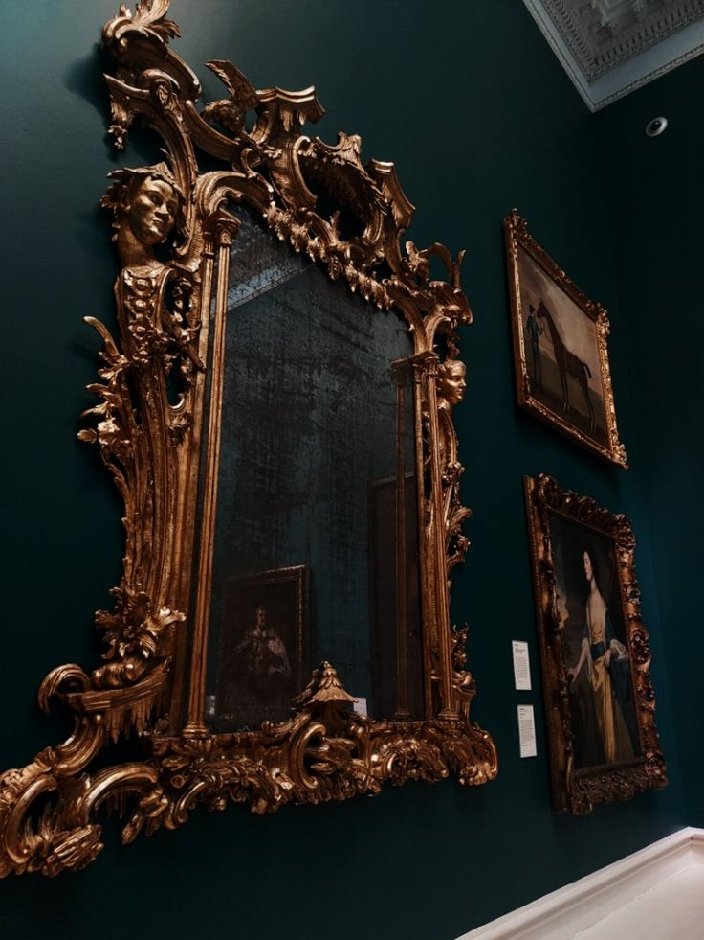
A short history of this mirror
Interestingly, Hazarduari Palace has a mystery mirror where the person who stands in front of it cannot see themselves, but others can. The mirror was planned to be placed at 90 degrees.
The reason behind this was to mislead the invaders who could harm the Nawab before they could realise that they were the target. This magic mirror is placed outside the gallery, and visitors try the experiment to know the story’s relevance.

Slide 5
So, it was all about our presentation
Thank you and have a nice day ahede
Credit goes to- Aritra Sarkar, tiasa bhattacharji

